Slide 1
E-Commerce Application
Ivana Koceva 211045
Ana Janeska 211008

Slide 2


What Is This Project About?
This application is an online shop for a crochet store selling handmade crafts. It is designed to provide users a seamless and efficient shopping experience.

Slide 3


Technologies Used
React
Firebase
Front-end
Components & Redux
Back-end
Database & Authentication

Slide 4
Features
1
Real-time Database Connectivity
2
User Authentication With Email And Google Account
3
Product Listings, Details And “Add To Cart” Functionality
4
Responsiveness Across All Devices

Slide 5
Pages

Slide 6
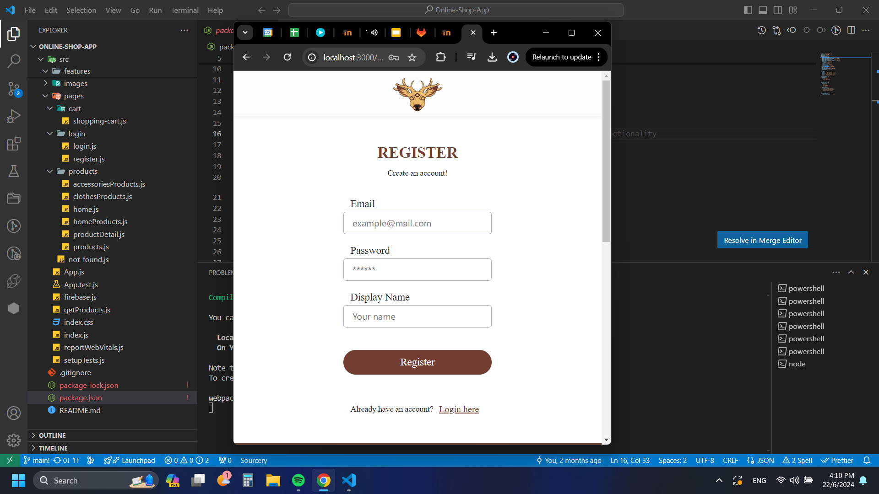
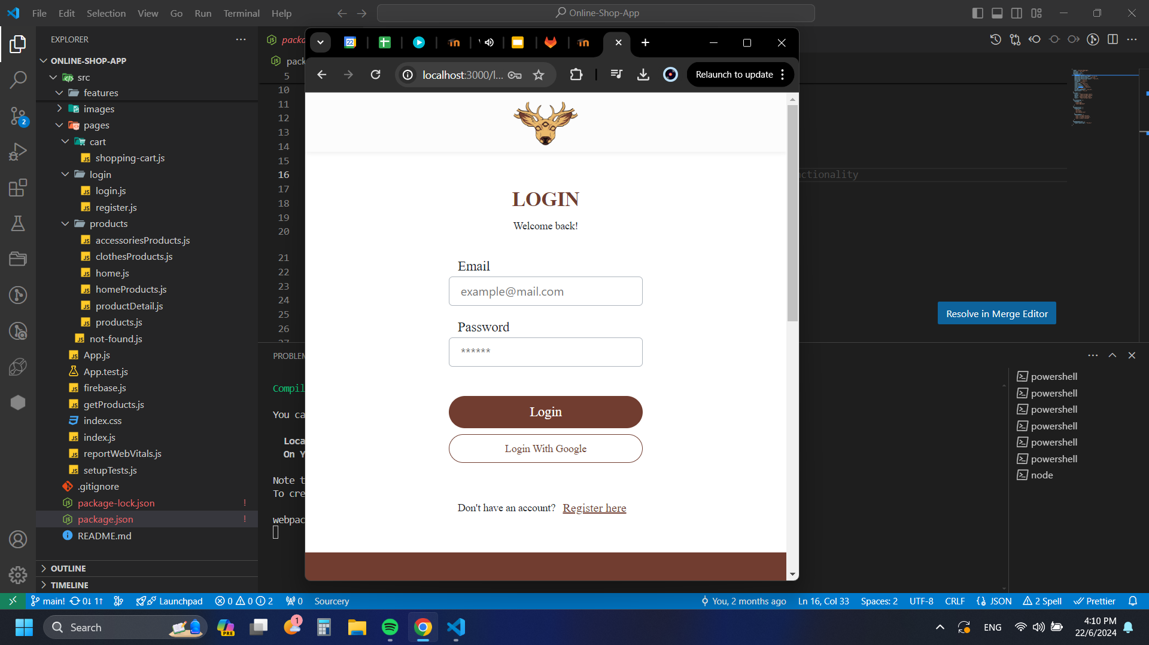
Login and Register

Slide 7
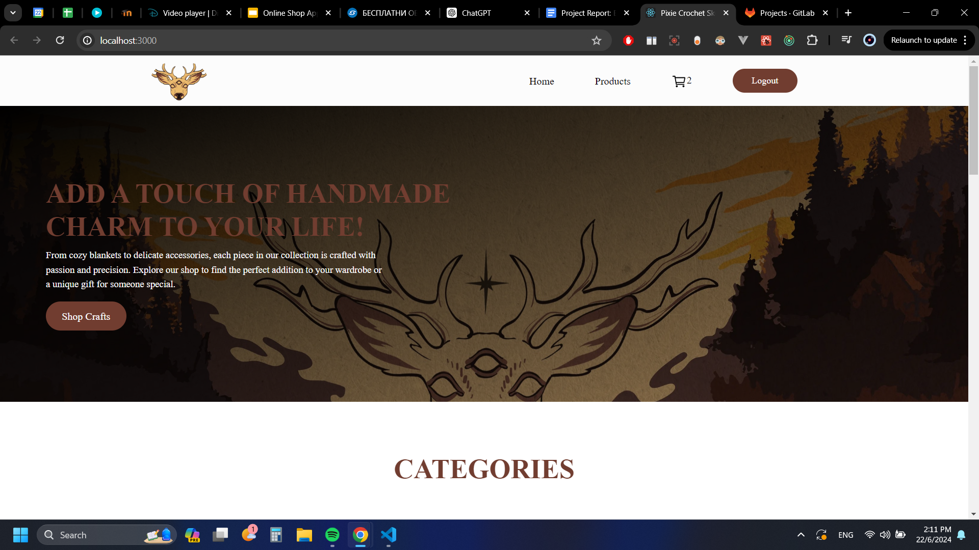
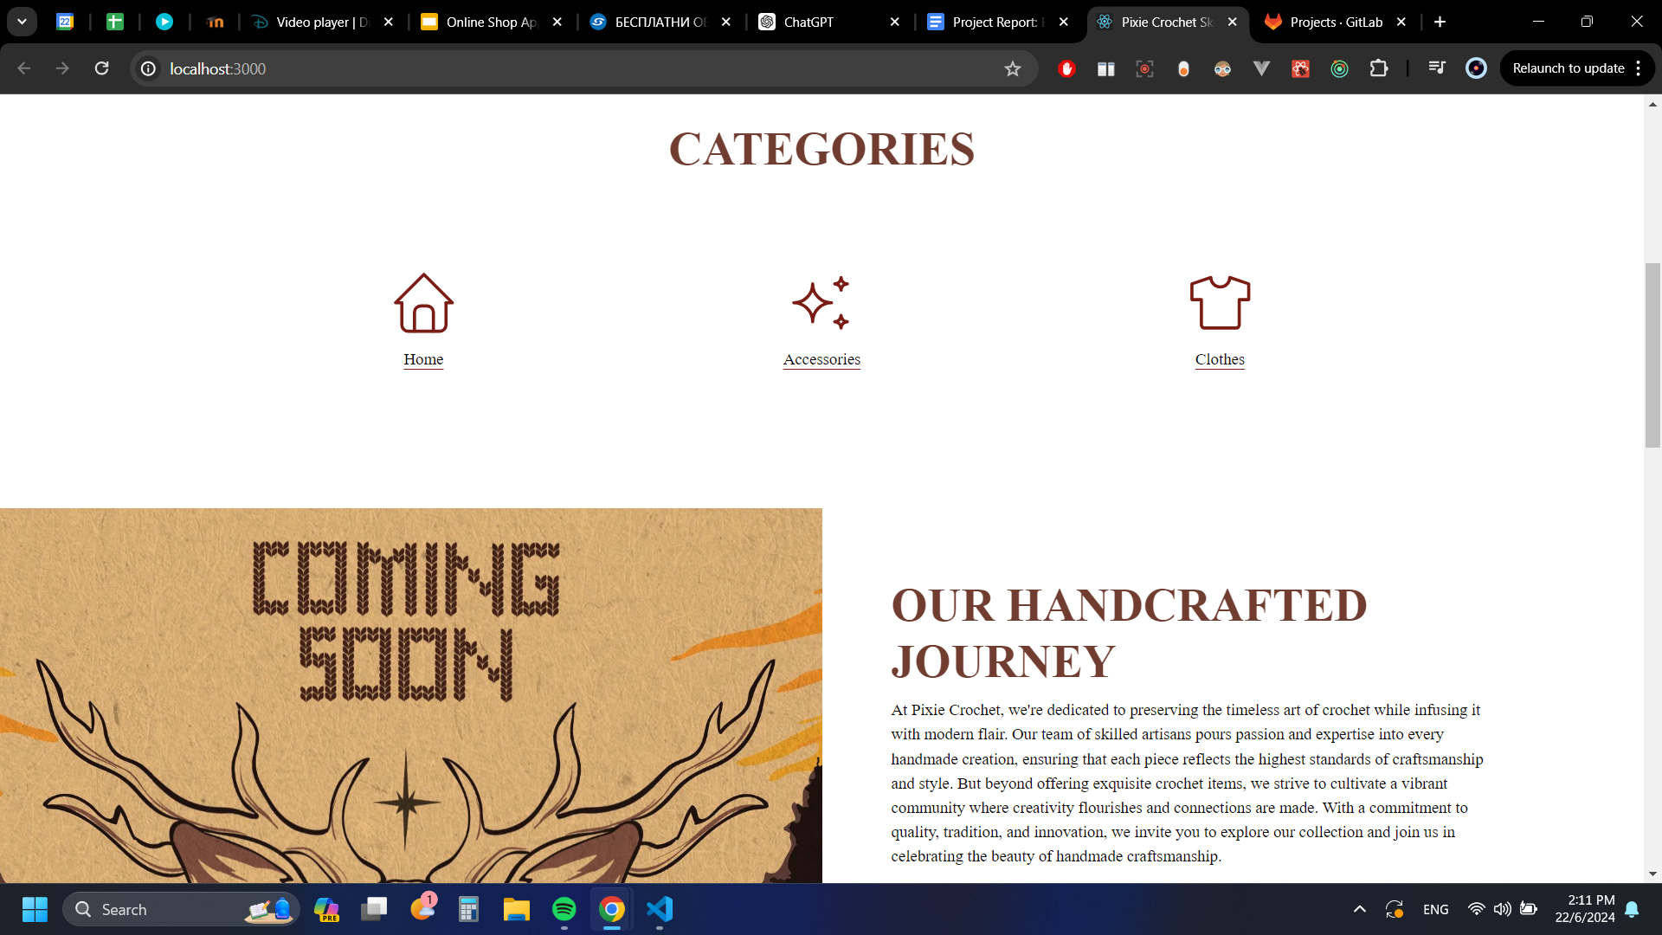

Slide 8
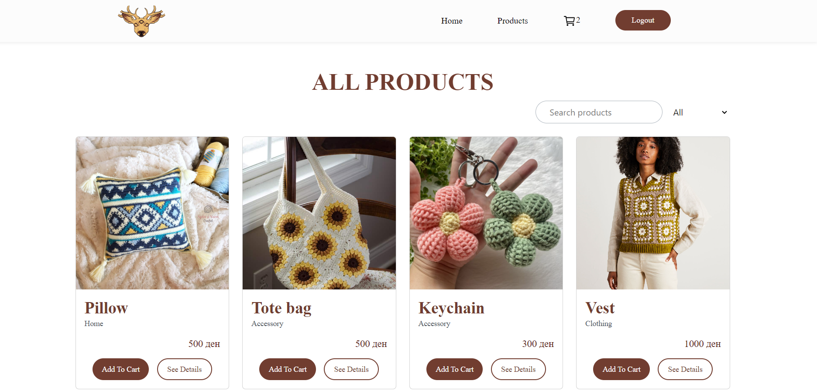

Slide 9
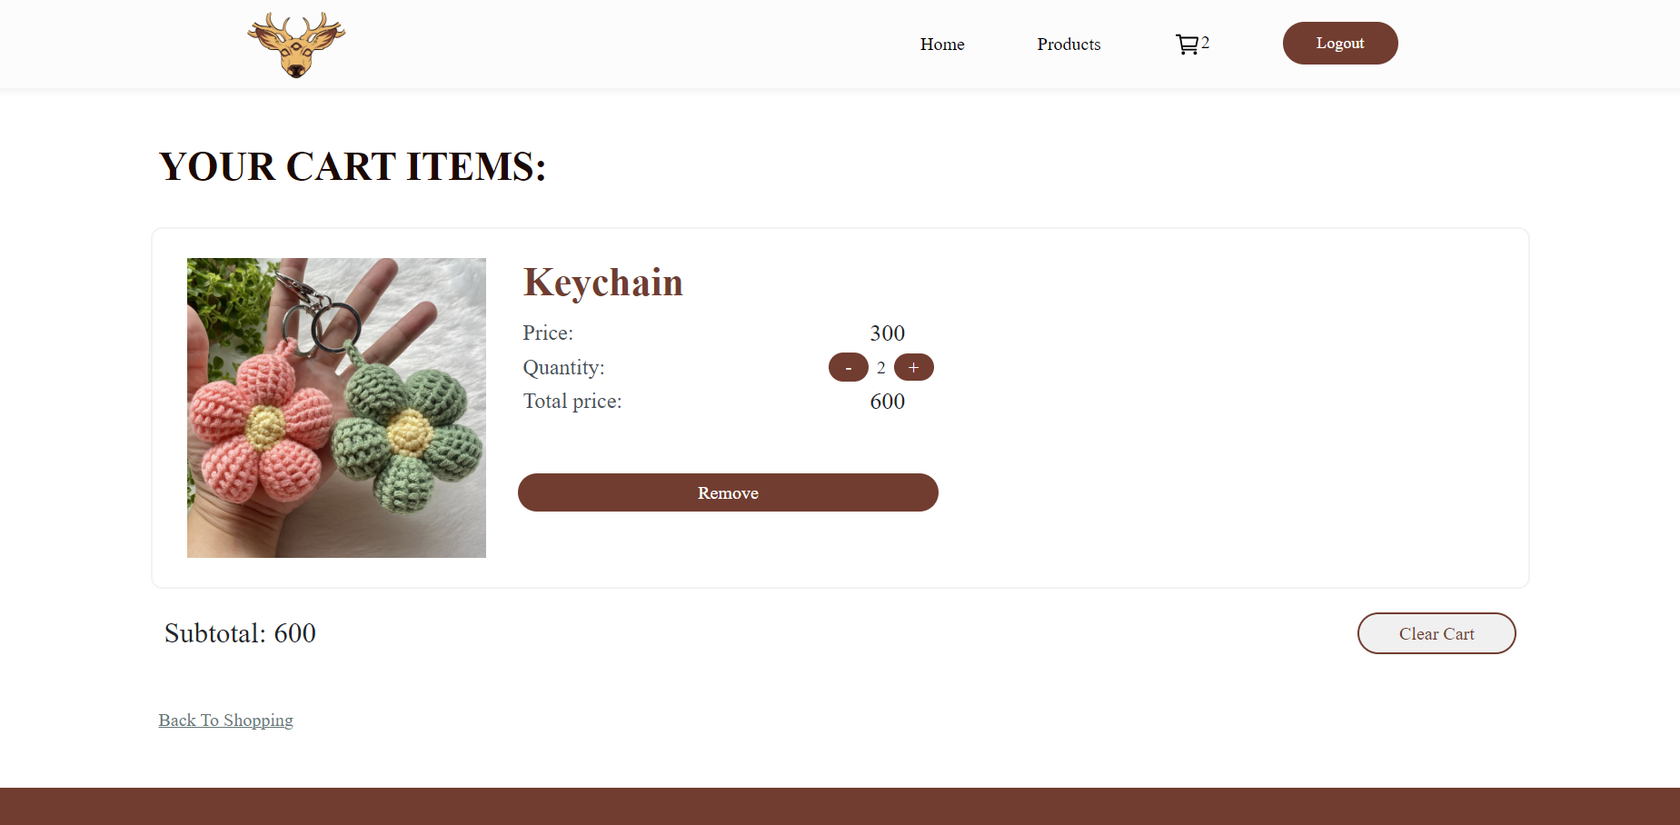

Slide 10
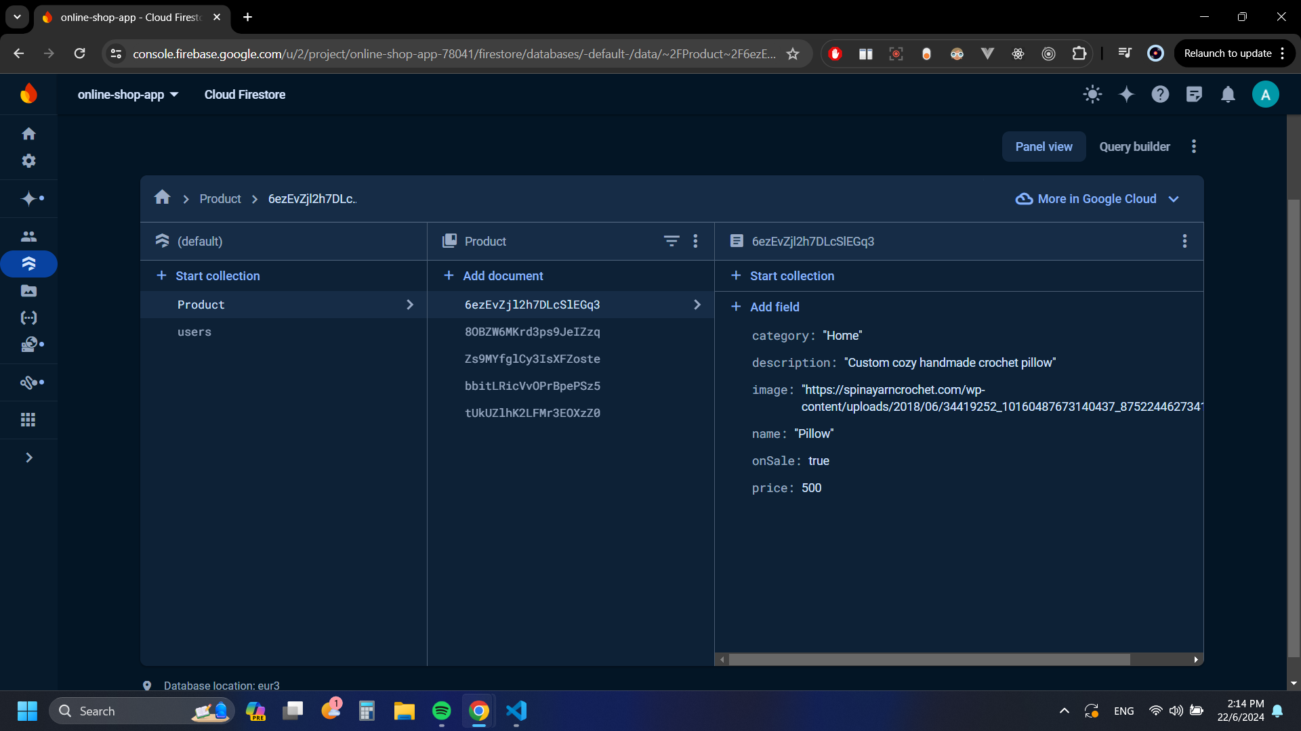
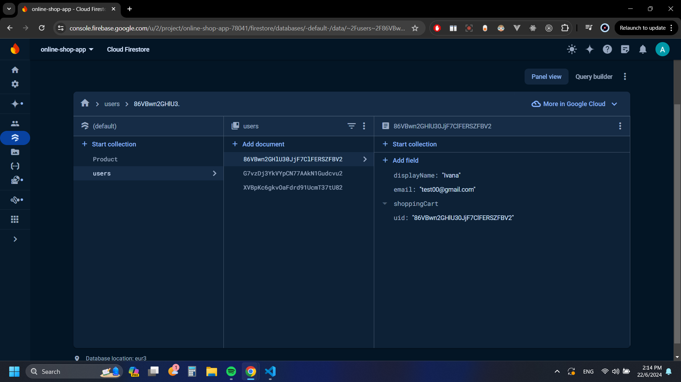
Firebase database

